Slide 1
Abstraction
Course Code:
Course Title: Object Oriented Programming -1(JAVA)
Dept. of Computer Science
Faculty of Science and Technology
Lecturer No: | 8 | Week No: | 9 | Semester: | Summer 21-22
Lecturer: | Mazid-Ul-Haque, mazid@aiub.edu

Slide 2
Lecture Outline
Abstraction
Abstract Class
Abstract Method
Final Keyword

Slide 3
Abstraction
Definition of Abstraction
It means ‘Hiding the Details’.
It is a process where implementation is hidden and its functionality is shown to user.

Slide 4
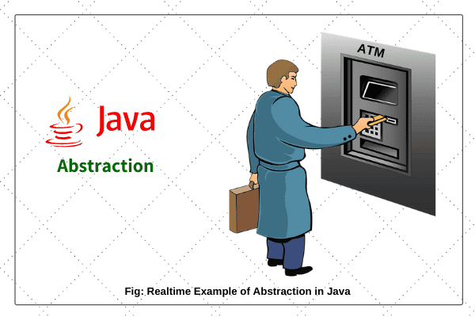
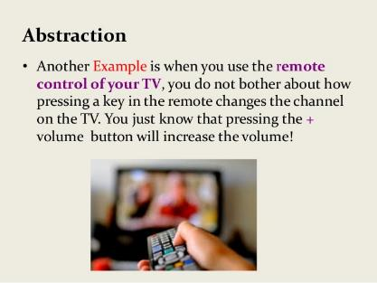
Abstraction
Example of Abstraction
Real Life Example:

Slide 5
Abstraction
In programming, this concept of hiding the details is known as abstraction.
We can hide the details of a class or a method.
Abstract Class
Abstract Method

Slide 6
Abstract Class
An abstract class is a class that we can not instantiate (can not create object).
However, We can use Object Reference of an abstract class.
The keyword abstract is used to denote abstract class.
public abstract class MyClass{. . .}

Slide 7
Abstract Class
An abstract class may have attributes.
An abstract class may have constructors but we can not call the constructors using the new keyword.
However, super( ), super(…), this( ), this(….) can be used to call constructors of an abstract class.

Slide 8
Abstract Class
An abstract class may have regular methods.
An abstract class may have abstract methods.
It is not necessary that an abstract class must have an abstract method.
So, it possible to have both regular methods and abstract methods in any number combination in a abstract class.

Slide 9
Abstract Class
An abstract class MUST have a child class.
This child class may be a regular class or may be another abstract class.
If the child class is another abstract class, that child class will have another child class which has to be a regular class.
So, at least one regular class will inherit the abstract class/classes in one way or the other.

Slide 10
Abstract Method
An abstract method is like a regular method but it does not have any body.
An abstract method is denoted with the keyword abstract.
public abstract void show( );
As, an abstract method does not have any body, it does not have the ‘{…}’. Instead, it has a ‘ ; ’ .

Slide 11
Abstract Method
An abstract method must be inside an abstract class.
As, an abstract class must have a child class, that child class should override/implement (give body to) all the abstract methods (if any) of that abstract class.
If it does not override/implement one/any of the abstract methods, the child class will have to be declared as another abstract class.

Slide 12
Example
public abstract class Alpha{ public void show( ){. . . } public void print( ){. . . } } public abstract class Bravo{ public abstract void show( ); public void print( ){. . . } } public abstract class Charlie{ public abstract void show( ); public abstract void print( ); } | public class MyAlpha extends Alpha{ public void display( ){. . . } } public class MyBravo extends Bravo{ public void display( ){. . . } public void show( ){. . .} } public class MyCharlie extends Charlie{ public void display( ){. . .} public void show( ){. . . } }
√
√
X

Slide 13
Example
public abstract class Alpha{ public void show( ){. . . } public void print( ){. . . } } public abstract class Bravo{ public abstract void show( ); public void print( ){. . . } } public abstract class Charlie{ public abstract void show( ); public abstract void print( ); } | public class MyAlpha extends Alpha{ public void display( ){. . . } } public class MyBravo extends Bravo{ public void display( ){. . . } public void show( ){. . .} } public abstract class MyCharlie extends Charlie{ public void display( ){. . .} public void show( ){. . . } }
√
√
√

Slide 14
Books
1. Java Complete Reference, 7th Edition, By Herbert Schildt.
2. A Programmer's Guide to Java SE 8 Oracle Certified Associate, Khalid A. MughalRolf W. Rasmussen
3. Java How to Program Java, 9th Edition, By Deitel and Deitel.
4. The Java Language Specification, By J. Gosling, B. Joy, G. Steele, G.Bracha and A. Buckley
5. Introduction to Programming Using Java, 6th Edition, By David j. Eck
6. Head First Java, By Kathy Sierra and Bert Bates

Slide 15
References
1. 1. Java Complete Reference, 7th Edition, By Herbert Schildt.
2. A Programmer's Guide to Java SE 8 Oracle Certified Associate, Khalid A. MughalRolf W. Rasmussen
2. The Java Tutorials. http://docs.oracle.com/javase/tutorial/

